Slide 1
Python Programming
Unit 1: Python Introduction

Slide 2
Python and its History
Python is a high-level, versatile programming language known for its readability and ease of use.
Python's journey began in the late 1980s when Guido van Rossum, a Dutch programmer, set out to create a language that was both powerful and easy to read.
The first official Python release, Python 0.9.0, came in February 1991.
The language's name was inspired by the British comedy group Monty Python, showcasing van Rossum's penchant for humor.
Python's success is largely attributed to its open-source nature.
Guido van Rossum handed over the language's development to a community of volunteers in 2000, fostering a collaborative environment.
This community-driven approach led to the continuous improvement and expansion of Python's capabilities.

Slide 3
Why Python?
Python is being extensively used in multiple domains.
Web Development: Django, Flask – Python dominates backend development and scripting in web projects.
Data Science: NumPy, Pandas, Matplotlib – Python is the preferred language for data manipulation, analysis, and visualization.
AI and ML: TensorFlow, PyTorch – Python leads in building and deploying advanced machine learning models.
Automation and Scripting: Versatile use in automation, system administration, and network programming.
Community and Libraries: Inclusive community, rich third-party libraries on PyPI.
Global Impact
Diverse Adoption: Used from startups to tech giants.
Educational Influence: Serves as a gateway into programming for learners worldwide.
Future Outlook
Continuous Evolution: Python Enhancement Proposal process ensures ongoing improvements.
Future Trends: Python poised to play a pivotal role in emerging technologies.

Slide 4
Python Characteristics
Readability: Python emphasizes code readability and clarity. Clean and easy-to-understand syntax reduces the cost of program maintenance and development.
Simplicity: Python's simplicity makes it an ideal language for beginners. Fewer lines of code are required to perform tasks compared to languages like C++ or Java.
Versatility: Python is a versatile language, suitable for a wide range of applications. It is used in web development, data science, artificial intelligence, automation, scripting, and more.
Interpretation: Python is an interpreted language, meaning it doesn't require compilation before execution. This allows for quick development and testing cycles.
Dynamic Typing: Python is dynamically typed, meaning variable types are interpreted during runtime. This provides flexibility but requires careful attention to variable types.
High-Level Language: Python is a high-level language, abstracting low-level details and providing a more user-friendly interface.
Large Standard Library: Python comes with a vast standard library that includes modules and packages for various tasks. This reduces the need for external libraries for many common programming tasks.
Community and Documentation: Python has a large and active community of developers. Extensive documentation and online resources make it easy for developers to find solutions and learn the language.

Slide 5
Python Characteristics Cont..
Platform Independence: Python is platform-independent, meaning Python code can run on different operating systems without modification.
Object-Oriented: Python supports object-oriented programming (OOP) principles. Encapsulation, inheritance, and polymorphism are integral to Python's OOP capabilities.
Extensibility: Python can be easily extended with modules written in C or C++, allowing integration with existing systems.
Ecosystem and Package Management: Python has a robust ecosystem with a package management system (pip) for easy installation and distribution of libraries.
Community-Driven Development: Python's development is guided by the Python Enhancement Proposal (PEP) process, which involves the Python community in decision-making.
Portability: Python programs can run on different platforms with minimal or no modifications, enhancing portability.
Scalability: Python is scalable, supporting both small scripts and large applications.

Slide 6
Python 2 vs. Python 3
The language underwent a significant shift with the introduction of Python 3 in December 2008.
This transition, while necessary for the language's growth, initially created a divide within the Python community.
Over time, however, the majority of developers migrated to Python 3, leaving Python 2 behind.
As of the latest developments, Python 2 is no longer officially supported.

Slide 7
Limitations of Python
Parallel processing can be done in Python but not as elegantly as done in some other languages (like JavaScript and Go Lang).
• Being an interpreted language, Python is slow as compared to C/C++. Python is not a very good choice for those developing a high-graphic 3d game that takes up a lot of CPU.
• As compared to other languages, Python is evolving continuously and there is little substantial documentation available for the language.
• As of now, there are few users of Python as compared to those using C, C++ or Java.
• It lacks true multiprocessor support.
• It has very limited commercial support point.
• Python is slower than C or C++ when it comes to computation heavy tasks and desktop applications.
• It is difficult to pack up a big Python application into a single executable file. This makes it difficult to distribute Python to non-technical.

Slide 8
Applications of Python
• Embedded scripting language: Python is used as an embedded scripting language for various testing/ building/ deployment/ monitoring frameworks, scientific apps, and quick scripts.
• 3D Software: 3D software like Maya uses Python for automating small user tasks, or for doing more complex integration such as talking to databases and asset management systems.
• Web development: Python is an easily extensible language that provides good integration with database and other web standards.
GUI-based desktop applications: Simple syntax, modular architecture, rich text processing tools and the ability to work on multiple operating systems makes Python a preferred choice for developing desktop-based applications.
• Image processing and graphic design applications: Python is used to make 2D imaging software such as Inkscape, GIMP, Paint Shop Pro and Scribus. It is also used to make 3D animation packages, like Blender, 3ds Max, Cinema 4D, Houdini, Lightwave and Maya.

Slide 9
Applications of Python
• Scientific and computational applications: Features like high speed, productivity and availability of tools, such as Scientific Python and Numeric Python, have made Python a preferred language to perform computation and processing of scientific data. 3D modeling software, such as FreeCAD, and finite element method software, like Abaqus, are coded in Python.
Games: Python has various modules, libraries, and platforms that support development of games. Games like Civilization-IV, Disney's Toontown Online, Vega Strike, etc. are coded using Python.
• Enterprise and business applications: Simple and reliable syntax, modules and libraries, extensibility, scalability together make Python a suitable coding language for customizing larger applications. For example, Reddit which was originally written in Common Lips, was rewritten in Python in 2005. A large part of Youtube code is also written in Python.
• Operating Systems: Python forms an integral part of Linux distributions.

Slide 10
Installing Python
1. Downloading Python
Visit the official Python website at python.org.
Navigate to the "Downloads" section.
Choose the appropriate version for your operating system (Windows, macOS, or Linux).
The latest version (Python 3.x) (Python 3.10 and above for 2024 Batch).
2. Running the Installer
For Windows:
Run the downloaded executable (.exe) file.
Check the box that says "Add Python to PATH" during the installation.
For macOS:
Run the downloaded package (.pkg) file.
For Linux:
Open a terminal and navigate to the directory containing the downloaded file.
Extract the tarball using the following command:
tar -xvf Python-3.x.x.tgz
Navigate into the extracted directory and run the following commands:
./configure
make
sudo make install

Slide 11
Installing Python Cont..
3. Verifying the Installation
Open a command prompt or terminal.
Type the following command to check the installed Python version:
python --version
You should see the installed Python version printed in the console.
4. IDEs (Optional)
Consider using an Integrated Development Environment (IDE) for a more efficient coding experience.
Popular Python IDEs include PyCharm, Visual Studio Code, and Jupyter Notebooks. Use Default IDE – “IDLE” initially.
5. Package Manager - pip
Python comes with a package manager called pip for easy installation of external libraries.
To check if pip is installed, type:
pip --version
For Python 3, use:
pip3 --version
6. Updating Python
Periodically check for Python updates to benefit from the latest features and security patches.
Use pip to update Python packages:
pip install --upgrade pip

Slide 12
Writing and Executing First Python Program
Step 1: Open an editor.
Step 2: Write the instructions
Step 3: Save it as a file with the filename having the extension .py.
Step 4: Run the interpreter with the command python program_name.py or use IDLE to run the programs.
To execute the program at the command prompt, simply change your working directory to C:\Python_prog (or move to the directory where you have saved Python) then type python program_name.py.
If you want to execute the program in Python shell, then just press F5 key or click on Run Menu and then select Run Module.

Slide 13
Executing Python from the Command Line
Running Python Scripts
Create a Python Script:
Use any text editor to write Python code and save it with a .py extension.
Execute a Script:
python3 script.py
Using Python IDLE: Open IDLE from search bar
Start typing basic commands in Interactive Mode
>>> 12*36
432
>>> 10*23+45/3
245.0
>>> a=10
>>> a*10
100
Starting with Script Mode:
Open file->New File
Write your python script e.g.
print(“HI!!! I am Indian”)
print(“Thank You”)
Save it and Execute using Run option ( Shortcut: F5)

Slide 14
Python Help Function
Getting Help: help() function
Syntax:
help(object_name)
Example: Try following commands in interactive mode
>>>help(print)
>>>help(id)

Slide 15
Literal Constants
The value of a literal constant can be used directly in programs. For example, 7, 3.9, 'A', and "Hello" are literal constants.
Numbers refers to a numeric value. You can use four types of numbers in Python program- integers, long integers, floating point and complex numbers.
• Numbers like 5 or other whole numbers are referred to as integers. Bigger whole numbers are called long integers. For example, 535633629843L is a long integer.
• Numbers like are 3.23 and 91.5E-2 are termed as floating point numbers.
• Numbers of a + bi form (like -3 + 7i) are complex numbers.
Examples:

Slide 16
Literal Constants
Strings
A string is a group of characters.
• Using Single Quotes ('): For example, a string can be written as 'HELLO'.
• Using Double Quotes ("): Strings in double quotes are exactly same as those in single quotes. Therefore, 'HELLO' is same as "HELLO".
• Using Triple Quotes (''' '''): You can specify multi-line strings using triple quotes. You can use as many single quotes and double quotes as you want in a string within triple quotes.
Examples:

Slide 17
Escape Sequences
Some characters (like ", \) cannot be directly included in a string. Such characters must be escaped by placing a backslash before them.
Example:

Slide 18
Raw Strings
If you want to specify a string that should not handle any escape sequences and want to display exactly as specified then you need to specify that string as a raw string. A raw string is specified by prefixing r or R to the string.
Example:

Slide 19
Variables and Identifiers
Variable means its value can vary. You can store any piece of information in a variable. Variables are nothing but just parts of your computer’s memory where information is stored. To be identified easily, each variable is given an appropriate name.
Identifiers are names given to identify something. This something can be a variable, function, class, module or other object. For naming any identifier, there are some basic rules like:
• The first character of an identifier must be an underscore ('_') or a letter (upper or lowercase).
• The rest of the identifier name can be underscores ('_'), letters (upper or lowercase), or digits (0-9).
• Identifier names are case-sensitive. For example, myvar and myVar are not the same.
• Punctuation characters such as @, $, and % are not allowed within identifiers.
Examples of valid identifier names are sum, __my_var, num1, r, var_20, First, etc.
Examples of invalid identifier names are 1num, my-var, %check, Basic Sal, H#R&A, etc.

Slide 20
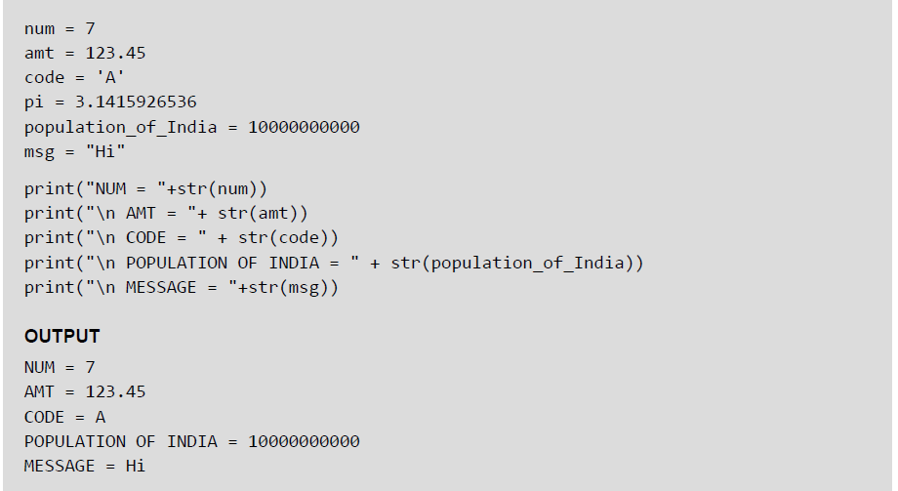
Assigning or Initializing Values to Variables
In Python, programmers need not explicitly declare variables to reserve memory space. The declaration is done automatically when a value is assigned to the variable using the equal sign (=). The operand on the left side of equal sign is the name of the variable and the operand on its right side is the value to be stored in that variable.
Example:

Slide 21
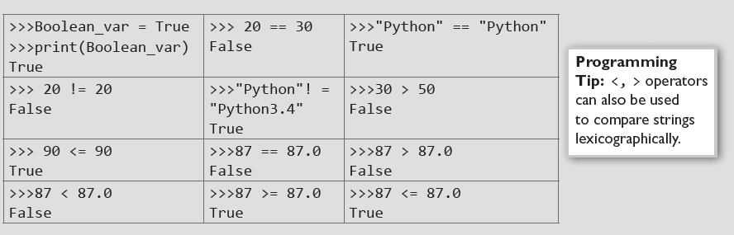
Data Type Boolean
Boolean is another data type in Python. A variable of Boolean type can have one of the two values- True or False. Similar to other variables, the Boolean variables are also created while we assign a value to them or when we use a relational operator on them.
Examples:

Slide 22
Input Operation
To take input from the users, Python makes use of the input() function. The input() function prompts the user to provide some information on which the program can work and give the result. However, we must always remember that the input function takes user’s input as a string.
Example:

Slide 23
Comments
Comments are the non-executable statements in a program. They are just added to describe the statements in the program code. Comments make the program easily readable and understandable by the programmer as well as other users who are seeing the code. The interpreter simply ignores the comments.
In Python, a hash sign (#) that is not inside a string literal begins a comment. All characters following the # and up to the end of the line are part of the comment
Example:

Slide 24
Indentation
Whitespace at the beginning of the line is called indentation. These whitespaces or the indentation are very important in Python. In a Python program, the leading whitespace including spaces and tabs at the beginning of the logical line determines the indentation level of that logical line.
Example:

Slide 25
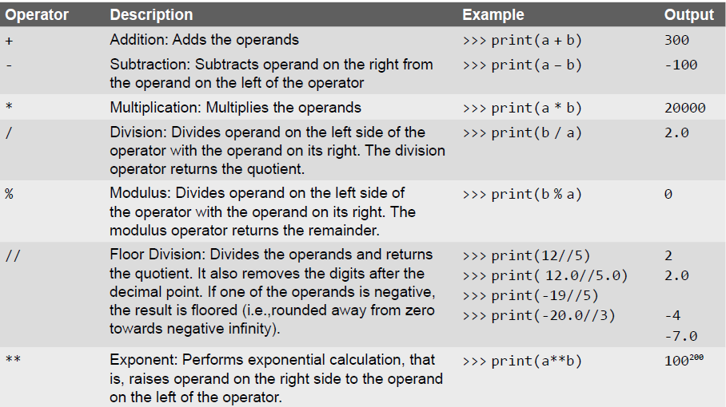
Arithmetic Operators

Slide 26
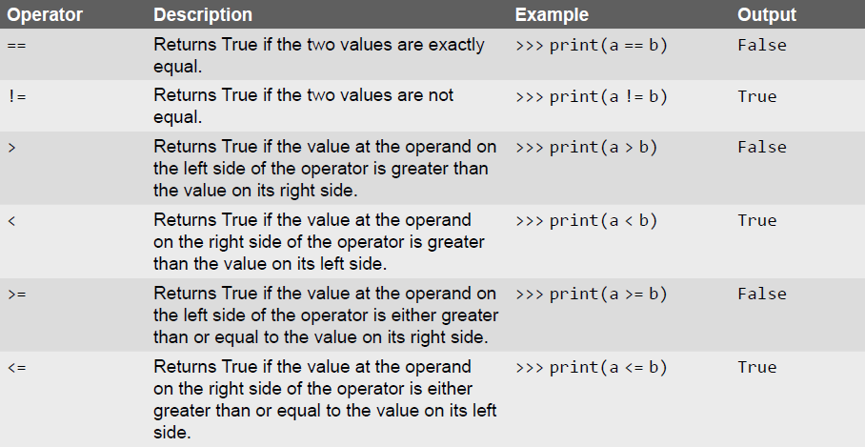
Comparison Operators

Slide 27
Unary Operators
Unary operators act on single operands. Python supports unary minus operator. Unary minus operator is strikingly different from the arithmetic operator that operates on two operands and subtracts the second operand from the first operand. When an operand is preceded by a minus sign, the unary operator negates its value.
For example, if a number is positive, it becomes negative when preceded with a unary minus operator. Similarly, if the number is negative, it becomes positive after applying the unary minus operator. Consider the given example.
b = 10 a = -(b)
The result of this expression, is a = -10, because variable b has a positive value. After applying unary minus operator (-) on the operand b, the value becomes -10, which indicates it as a negative value.

Slide 28
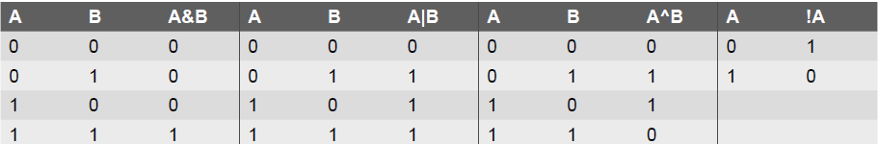
Bitwise Operators
As the name suggests, bitwise operators perform operations at the bit level. These operators include bitwise AND, bitwise OR, bitwise XOR, and shift operators. Bitwise operators expect their operands to be of integers and treat them as a sequence of bits.
The truth tables of these bitwise operators are given below.

Slide 29
Shift Operators
Python supports two bitwise shift operators. They are shift left (<<) and shift right (>>). These operations are used to shift bits to the left or to the right. The syntax for a shift operation can be given as follows:
Examples:

Slide 30
Logical Operators
Logical AND (&&) operator is used to simultaneously evaluate two conditions or expressions with relational operators. If expressions on both the sides (left and right side) of the logical operator are true, then the whole expression is true. For example, If we have an expression (a>b) && (b>c), then the whole expression is true only if both expressions are true. That is, if b is greater than a and c.
Logical OR (||) operator is used to simultaneously evaluate two conditions or expressions with relational operators. If one or both the expressions of the logical operator is true, then the whole expression is true. For example, If we have an expression (a>b) || (b>c), then the whole expression is true if either b is greater than a or b is greater than c.
Logical not (!) operator takes a single expression and negates the value of the expression. Logical NOT produces a zero if the expression evaluates to a non-zero value and produces a 1 if the expression produces a zero. In other words, it just reverses the value of the expression. For example, a = 10, b b = !a; Now, the value of b = 0. The value of a is not zero, therefore, !a = 0. The value of !a is assigned to b, hence, the result.

Slide 31
Membership and Identity Operators
Python supports two types of membership operators–in and not in. These operators, test for membership in a sequence such as strings, lists, or tuples.
in Operator: The operator returns true if a variable is found in the specified sequence and false otherwise. For example, a in nums returns 1, if a is a member of nums.
not in Operator: The operator returns true if a variable is not found in the specified sequence and false otherwise. For example, a not in nums returns 1, if a is not a member of nums.
Identity Operators
is Operator: Returns true if operands or values on both sides of the operator point to the same object and false otherwise. For example, if a is b returns 1, if id(a) is same as id(b).
is not Operator: Returns true if operands or values on both sides of the operator does not point to the same object and false otherwise. For example, if a is not b returns 1, if id(a) is not same as id(b).

Slide 32
Expressions
An expression is any legal combination of symbols (like variables, constants and operators) that represents a value. In Python, an expression must have at least one operand (variable or constant) and can have one or more operators. On evaluating an expression, we get a value. Operand is the value on which operator is applied.
Constant Expressions: One that involves only constants. Example: 8 + 9 – 2
Integral Expressions: One that produces an integer result after evaluating the expression. Example:
a = 10
• Floating Point Expressions: One that produces floating point results. Example: a * b / 2
• Relational Expressions: One that returns either true or false value. Example: c = a>b
• Logical Expressions: One that combines two or more relational expressions and returns a value as True or False. Example: a>b && y! = 0
• Bitwise Expressions: One that manipulates data at bit level. Example: x = y&z
• Assignment Expressions: One that assigns a value to a variable. Example: c = a + b or c = 10

Slide 33
Operations on Strings
Examples:

Slide 34
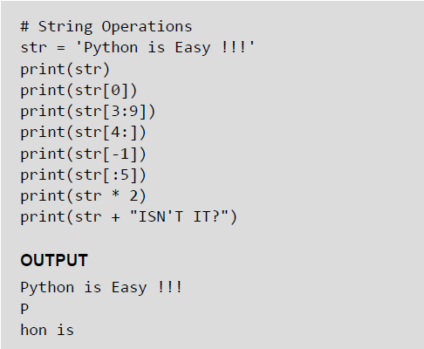
Slice Operations on Strings
You can extract subsets of strings by using the slice operator ([ ] and [:]). You need to specify index or the range of index of characters to be extracted. The index of the first character is 0 and the index of the last character is n-1, where n is the number of characters in the string.
If you want to extract characters starting from the end of the string, then you must specify the index as a negative number. For example, the index of the last character is -1.
Examples:

Slide 35
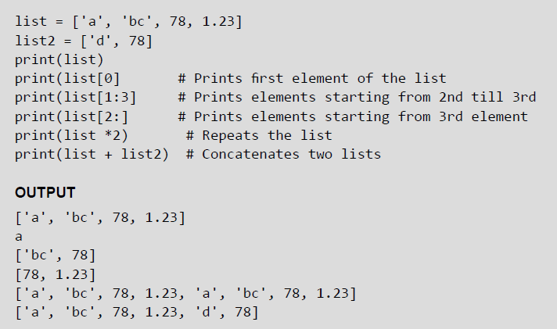
Lists
Lists are the most versatile data type of Python language. A list consist of items separated by commas and enclosed within square brackets The values stored in a list are accessed using indexes. The index of the first element being 0 and n-1 as that of the last element, where n is the total number of elements in the list. Like strings, you can also use the slice, concatenation and repetition operations on lists.
Examples:

Slide 36
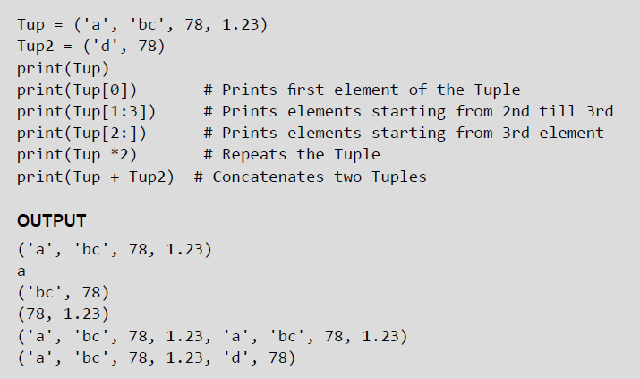
Tuples
A tuple is similar to the list as it also consists of a number of values separated by commas and enclosed within parentheses. The main difference between lists and tuples is that you can change the values in a list but not in a tuple. This means that while tuple is a read only data type, the list is not.
Examples:

Slide 37
Dictionary
Python’s dictionaries stores data in key-value pairs. The key values are usually strings and value can be of any data type. The key value pairs are enclosed with curly braces ({ }). Each key value pair separated from the other using a colon (:). To access any value in the dictionary, you just need to specify its key in square braces ([]).Basically dictionaries are used for fast retrieval of data
Example:

Slide 38
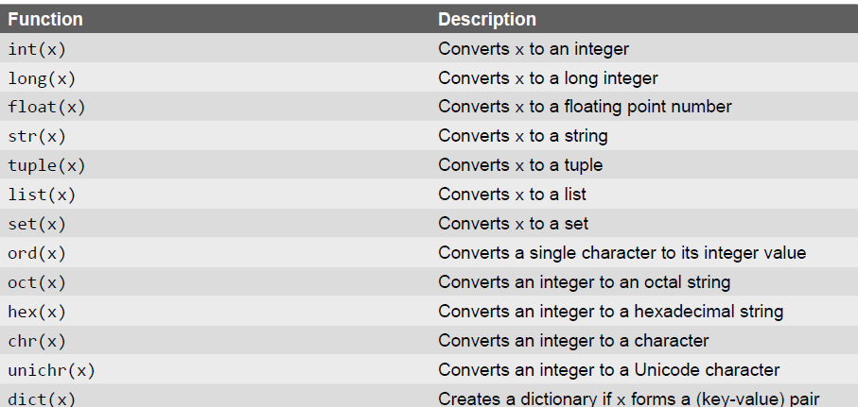
Type Conversion
In Python, it is just not possible to complete certain operations that involves different types of data. For example, it is not possible to perform "2" + 4 since one operand is an integer and the other is of string type.
Example:

Slide 39
Type Casting vs Type Coercion
In the last slide, we have done explicit conversion of a value from one data type to another. This is known as type casting.
However, in most of the programming languages including Python, there is an implicit conversion of data types either during compilation or during run-time. This is also known type coercion. For example, in an expression that has integer and floating point numbers (like 21 + 2.1 gives 23.1), the compiler will automatically convert the integer into floating point number so that fractional part is not lost.

Slide 40
Control Statements
A control statement is a statement that determines the control flow of a set of instructions, i.e., it decides the sequence in which the instructions in a program are to be executed.
Types of Control Statements —
Sequential Control: A Python program is executed sequentially from the first line of the program to its last line.
Selection Control: To execute only a selected set of statements.
Iterative Control: To execute a set of statements repeatedly.

Slide 41
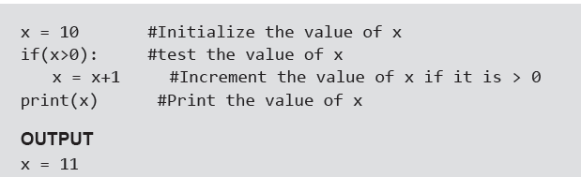
If Statement
Example:

Slide 42
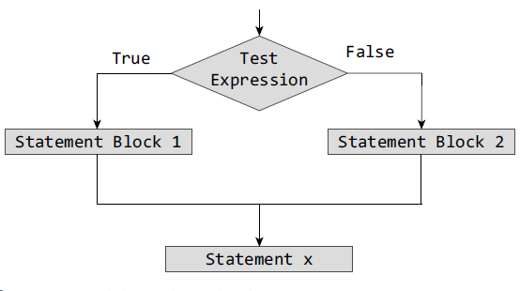
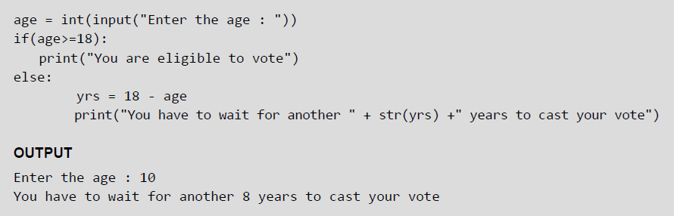
If-Else Statement
Example:

Slide 43
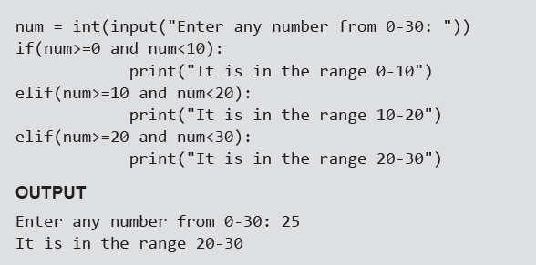
Nested if Statements
A statement that contains other statements is called a compound statement. To perform more complex checks, if statements can be nested, that is, can be placed one inside the other. In such a case, the inner if statement is the statement part of the outer one. Nested if statements are used to check if more than one conditions are satisfied.
Example:

Slide 44
If-elif-else Statement
Python supports if-elif-else statements to test additional conditions apart from the initial test expression. The if-elif-else construct works in the same way as a usual if-else statement. If-elif-else construct is also known as nested-if construct.
Example:

Slide 45
While Loop
Example:

Slide 46
For Loop
For loop provides a mechanism to repeat a task until a particular condition is True. It is usually known as a determinate or definite loop because the programmer knows exactly how many times the loop will repeat.
The for...in statement is a looping statement used in Python to iterate over a sequence of objects.

Slide 47
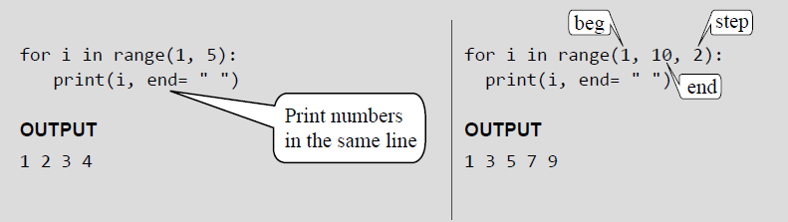
For Loop and Range() Function
The range() function is a built-in function in Python that is used to iterate over a sequence of numbers. The syntax of range() is range(beg, end, [step])
The range() produces a sequence of numbers starting with beg (inclusive) and ending with one less than the number end. The step argument is option (that is why it is placed in brackets). By default, every number in the range is incremented by 1 but we can specify a different increment using step. It can be both negative and positive, but not zero.
Examples:

Slide 48
Range() Function
If range() function is given a single argument, it produces an object with values from 0 to argument-1. For example: range(10) is equal to writing range(0, 10).
• If range() is called with two arguments, it produces values from the first to the second. For example, range(0,10).
• If range() has three arguments then the third argument specifies the interval of the sequence produced. In this case, the third argument must be an integer. For example, range(1,20,3).
Examples:

Slide 49
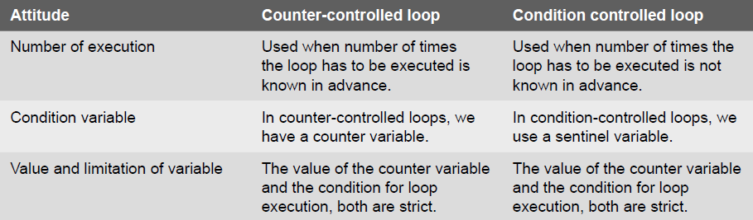
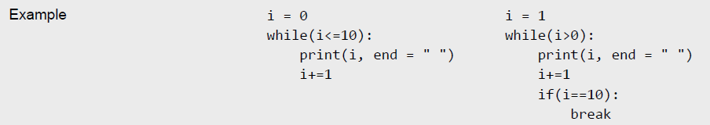
Condition-controlled and Counter-controlled Loops

Slide 50
Nested Loops
Python allows its users to have nested loops, that is, loops that can be placed inside other loops. Although this feature will work with any loop like while loop as well as for loop.
A for loop can be used to control the number of times a particular set of statements will be executed. Another outer loop could be used to control the number of times that a whole loop is repeated.
Loops should be properly indented to identify which statements are contained within each for statement.
Example:

Slide 51
The Break Statement
The break statement is used to terminate the execution of the nearest enclosing loop in which it appears. The break statement is widely used with for loop and while loop. When compiler encounters a break statement, the control passes to the statement that follows the loop in which the break statement appears.
Example:

Slide 52
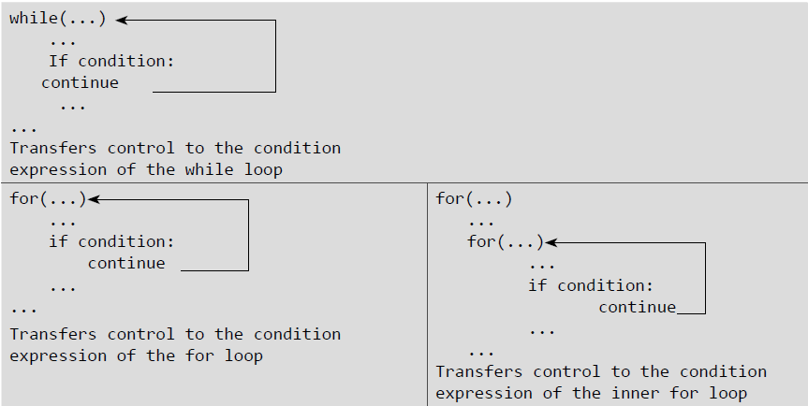
The Continue Statement
Like the break statement, the continue statement can only appear in the body of a loop. When the compiler encounters a continue statement then the rest of the statements in the loop are skipped and the control is unconditionally transferred to the loop-continuation portion of the nearest enclosing loop.
Example:

Slide 53
The Pass Statement
Pass statement is used when a statement is required syntactically but no command or code has to be executed. It specified a null operation or simply No Operation (NOP) statement. Nothing happens when the pass statement is executed.
Difference between comment and pass statements In Python programming, pass is a null statement. The difference between a comment and pass statement is that while the interpreter ignores a comment entirely, pass is not ignored. Comment is not executed but pass statement is executed but nothing happens.
Example:

Slide 54
The Else Statement Used With Loops
Unlike C and C++, in Python you can have the else statement associated with a loop statements. If the else statement is used with a for loop, the else statement is executed when the loop has completed iterating. But when used with the while loop, the else statement is executed when the condition becomes false.
Examples:

Slide 55
Structural Pattern Matching (Match)
Structural Pattern Matching, also known as pattern matching or match statement, is a feature introduced in Python 3.10. It allows developers to write more expressive and concise code, inspired by similar constructs in languages like C, Rust, F#, and Haskell.
Syntax:
match value:
case pattern1:
# code to execute if pattern1 matches
case pattern2:
# code to execute if pattern2 matches
...
case _:
# code to execute if none of the above patterns match
value: The variable or expression to be matched.
case: Specifies a matching pattern.
_: A wildcard pattern that matches anything (catch-all for unmatched patterns).
Example:
match value:
case "hello":
print("The value is 'hello'")
case 42:
print("The value is 42")

Slide 56
Structural Pattern Matching (Match)
Examples:
Mapping patterns: These patterns match against a mapping data structure like a dictionary.
match value:
case {}:
print("The dictionary is empty")
case {"name": name, "age": age}:
print(f"The person's name is {name} and age is {age}")
Variable patterns: These patterns match against a variable and bind the value to the variable.
match value:
case x:
print("The value is “,x)
Type patterns: These patterns match against a specific type.
match value:
case int:
print("The value is an integer")
case str:
print("The value is a string")
Sequence patterns: These patterns match against a sequence data structure like a tuple, list, or string.
match value:
case []:
print("The list is empty")
case [x, y]:
print(f"The first two elements of the list are {x} and {y}")
case [x, *rest]:
print(f"The first element of the list is {x} and the rest of the elements are {rest}")

Slide 57
Structural Pattern Matching (Match)
Examples:
Combining patterns: We can also combine patterns using logical operators like `|` (or), `&` (and), and `not.`
match value:
case int | float:
print("The value is a number")
case [x, y] & isinstance(x, str):
print("The first element is a string")
case not []:
print("The value is not an empty list")

